Slide 1
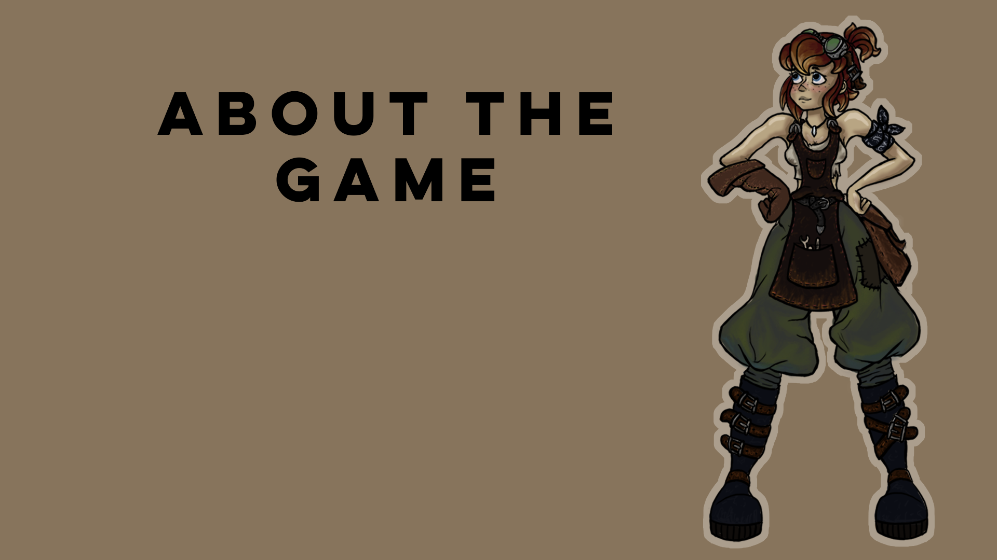
Hollow
(working title)

Slide 2
ABOUT THE GAME
GAMEPLAY AND GENRE

Slide 3
THE STORY
Gearona is a young woman living in the small town Terrahaven, known for its many caves. She is an orphan, living and working with her Grandpa in his Tinksmith shop. A Tinksmith is the combination of a tinker and a blacksmith and is known for making new handy invention. Inventions like Trickster, a small helper robot that Gearona invented together with Grandpa when she was 7 years old. Life is peaceful in Terrahaven until everything changes for Gearona.
When Gearona comes back to the shop after scavenging for some parts for a new invention she is shocked to find the workspace is a mess and Grandpa is missing! Trickster comes out of hiding, points towards a children’s book and claims that Grandpa has been taken to a fairytale underground world known as “Hollow.” Gearona, a woman of science rejects this claim when suddenly Grandpa’s voice emerges from the radio: “Gearona…Hollow….help!”
Gearona’s decision is made; she wants to save Grandpa, no matter what!
Gearona can’t help but wonder: Where was he brought? Who is behind all this? And above all. Why was Grandpa taken?
Travel and explore a forgotten, fantastical world along Gearona’s side. Experience a thrilling story, unravel the past and discover an unbelievable secret!
Maybe Story all plotpoints and world?

Slide 4
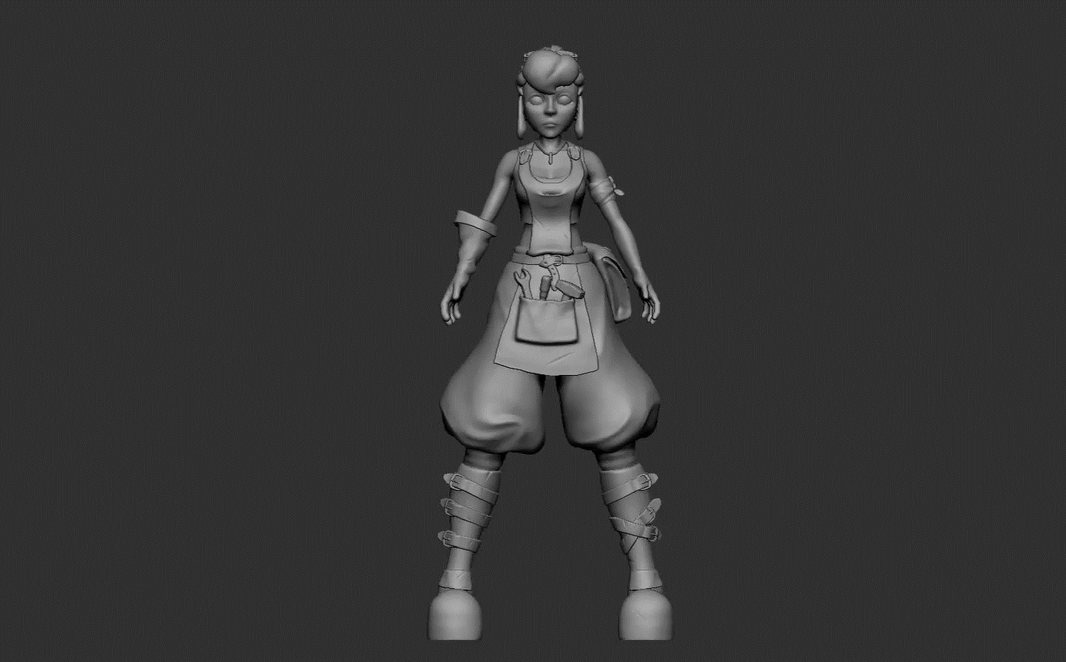
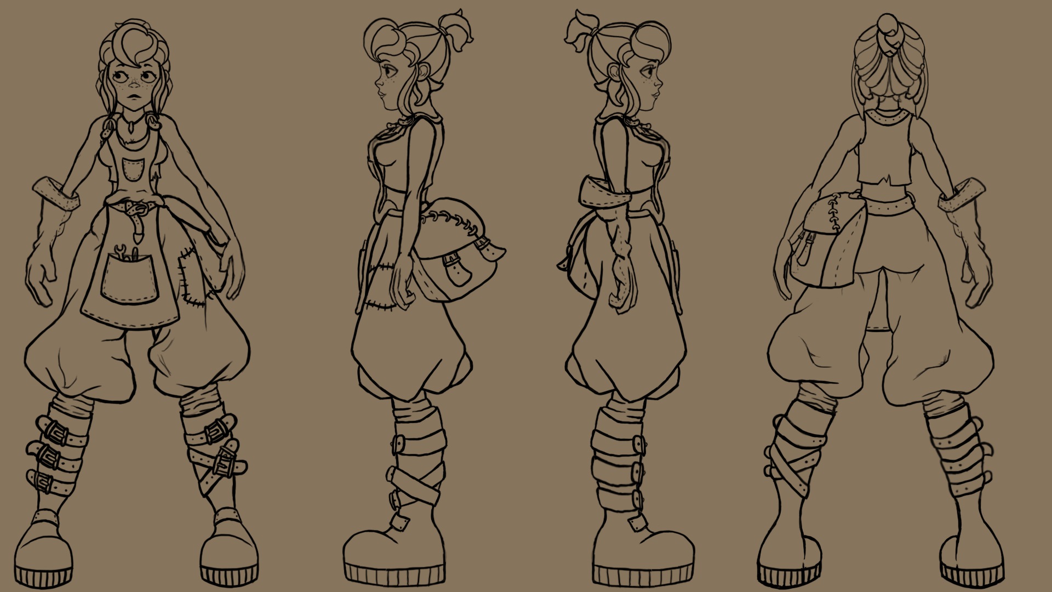
ART/ CURRENT PROGRESS

Slide 5
OUR GOAL
Proof of concept
Demo
Kickstarter
Indie game and starting company

